Slide 1
Sweetgreen analytics exercise
Heather Cohen

Slide 2
Dates & Seasonality
What are the trends?

Slide 3
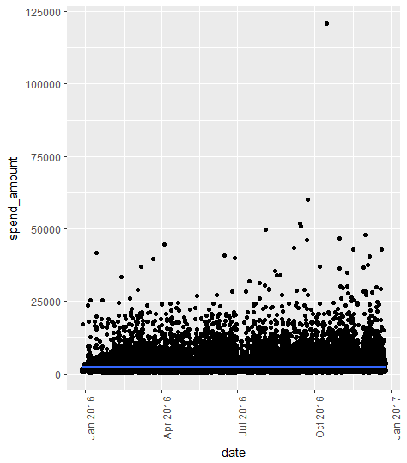
No Obvious Seasonality In Sales
No yearly trending since there are so many outliers

Slide 4
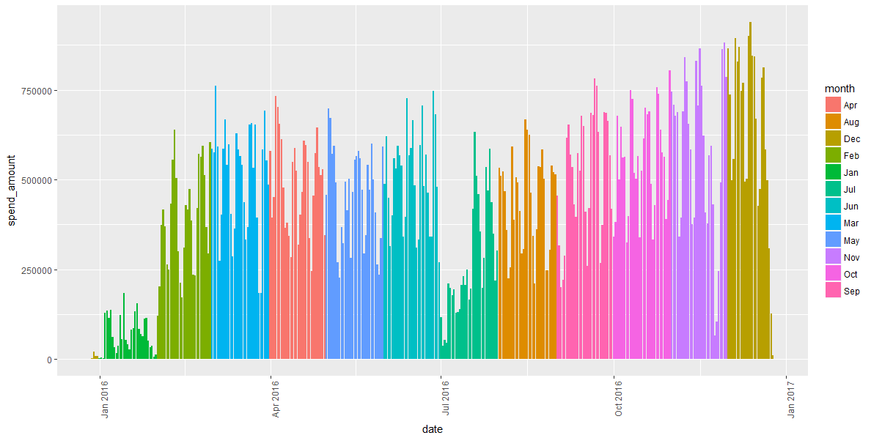
Closer Inspection : Some Months Better Than Others

Slide 5
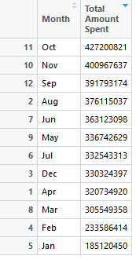
Fall is the winner
Beating out summer and spring by a fair amount, in cumulative total sales, October and the fall are the winners
Further questions: was it because there was a really warm fall? Could index weather info from the major stores and see if they correlate

Slide 6
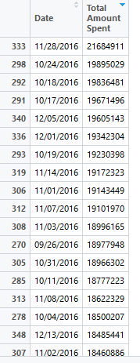
End of the year had the busiest single days
I would’ve have guessed salad was what people in NY craved in November and December
But it is!

Slide 7
Location, Location,
…location

Slide 8
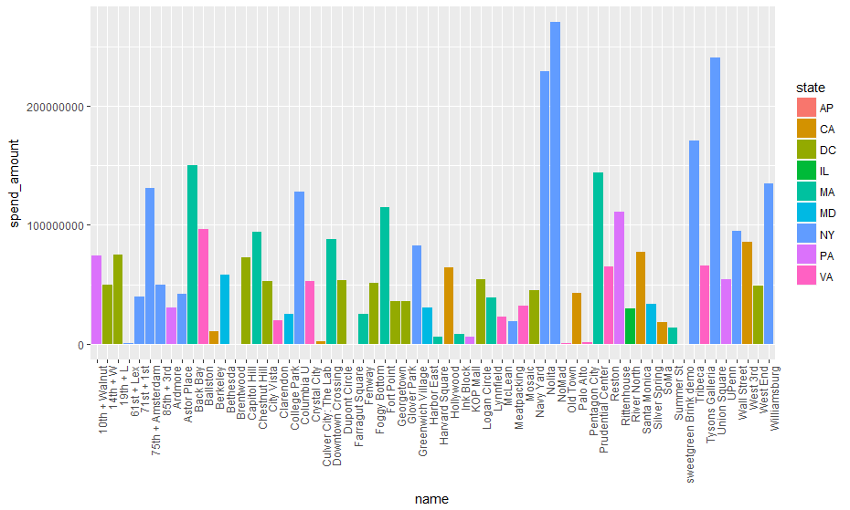
NY & MA dominate in overall spending

Slide 9
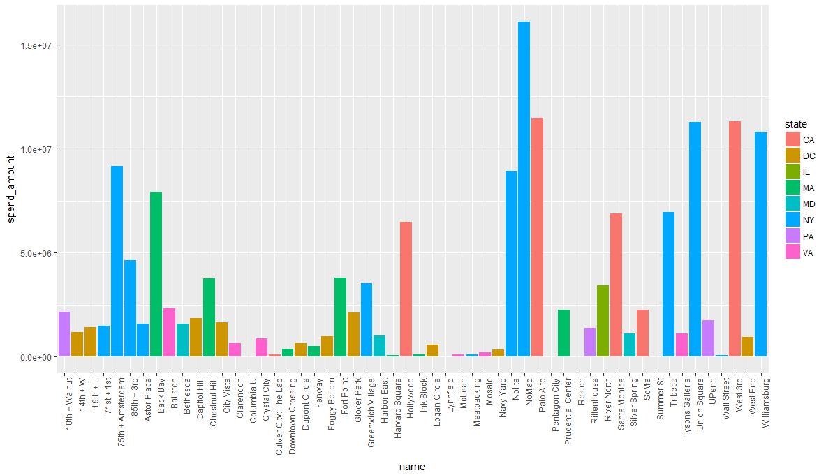
But, of the HighValue subset, it’s NY & CA

Slide 10
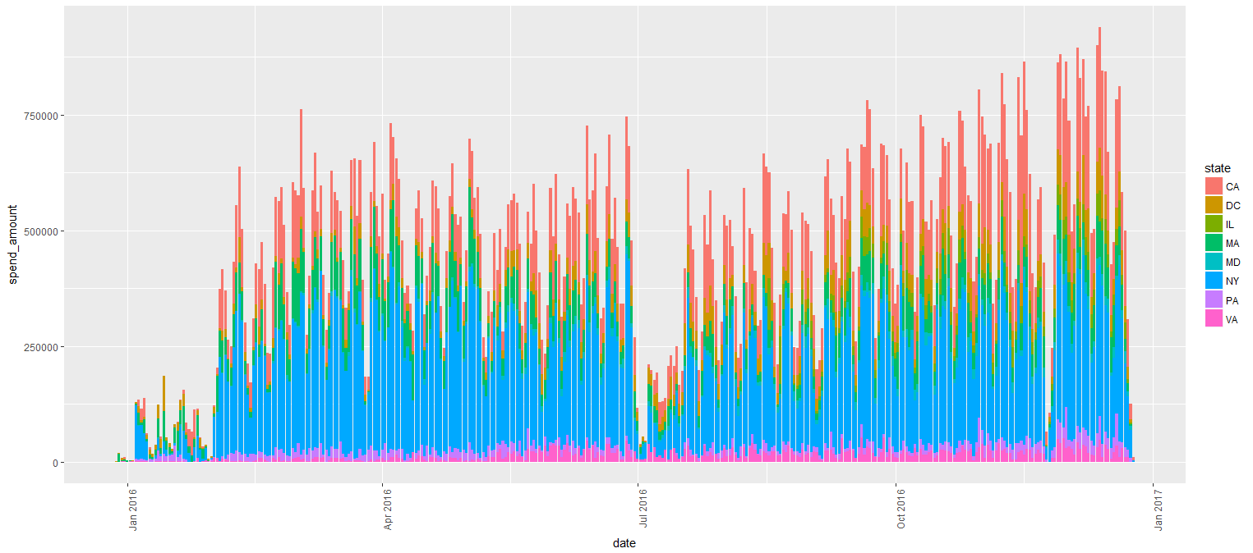
Spending By State – High Value NY & CA Lead

Slide 11
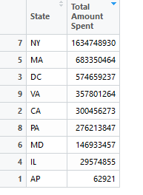
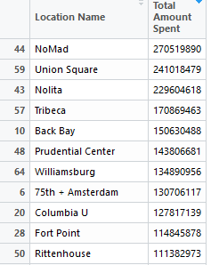
MA beats out CA by several spots for 2nd in overall sales
CA has a bunch of busy stores but none of them are in the top 10
CA stores see a higher volume of orders, even if their net total isn’t as high

Slide 12
Items
Certain items sell waaaaay more than others

Slide 13
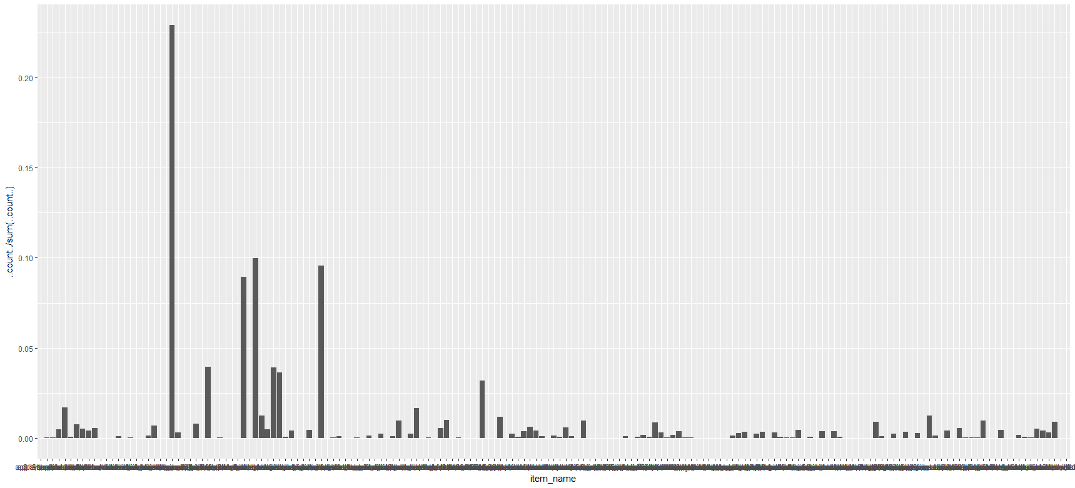
Such a huge difference

Slide 14
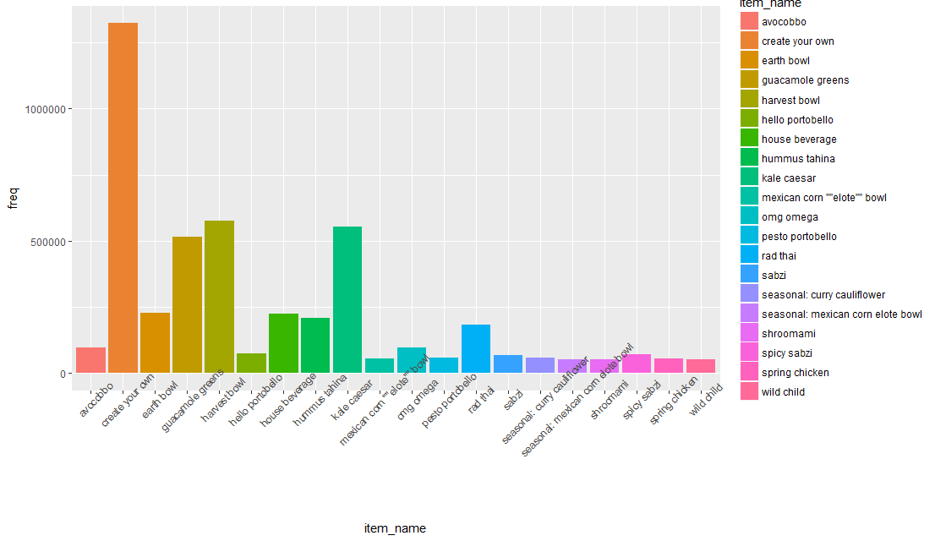
Create your own is super popular across the whole database (this is the top 20)

Slide 15
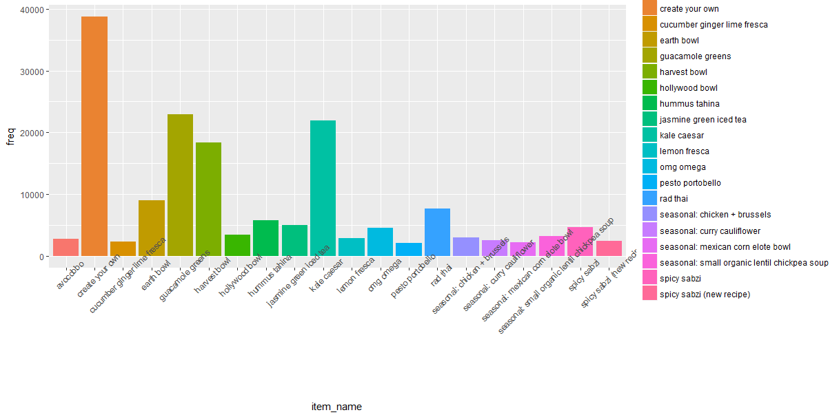
From just the high value set: Create your own still wins but guac greens and jasmine tea are more popular. Jasmine tea wasn’t even in the top 20 before

Slide 16
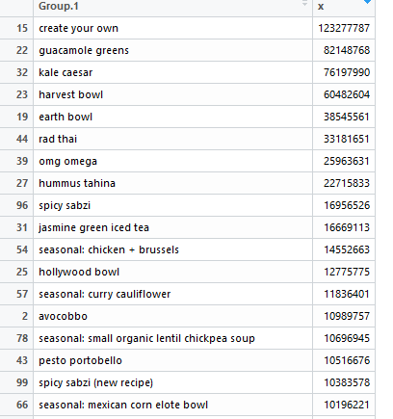
Numerical presentation of the last graph
High value subset really like jasmine iced tea

Slide 17
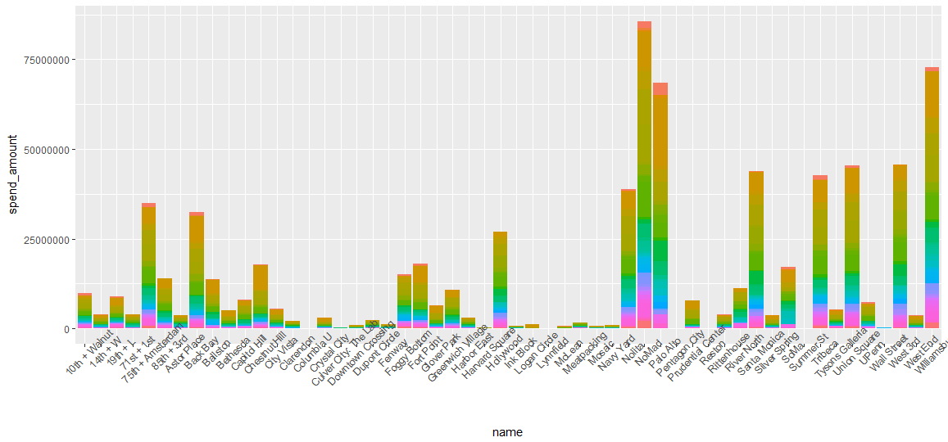
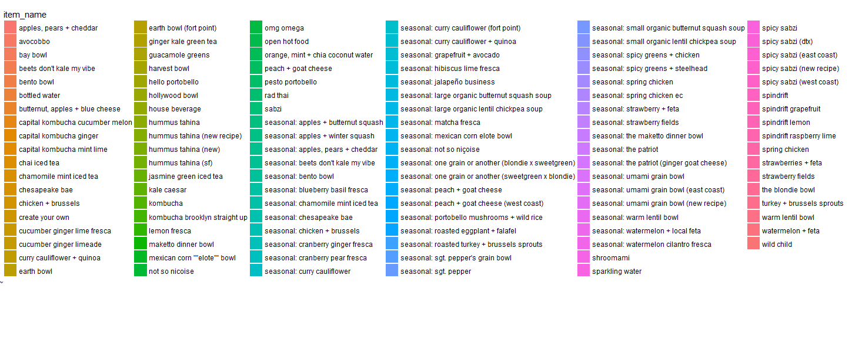
Guac and hummus are a lot of the sales

Slide 18
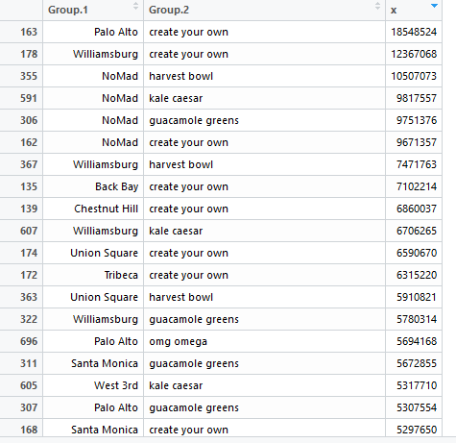
Most money spent on items by location
CA loves guacamole more than other states (duh)
Create your own is the winner almost everywhere

Slide 19
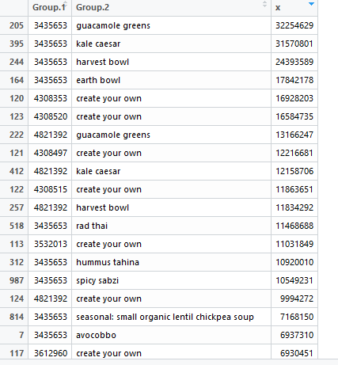
Top users – Top Item Bought – Total Amount Spent on it
A couple users spend a lot on guacamole & kale

Slide 20
Times
Does time of day have an impact? Probably

Slide 21
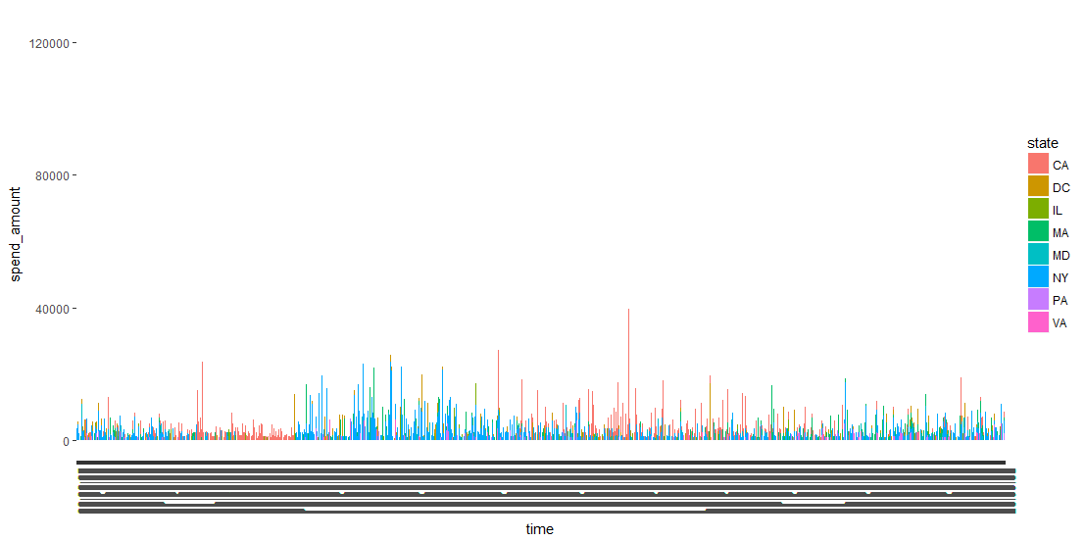
Time of Day Impacts Where Money is Spent

Slide 22
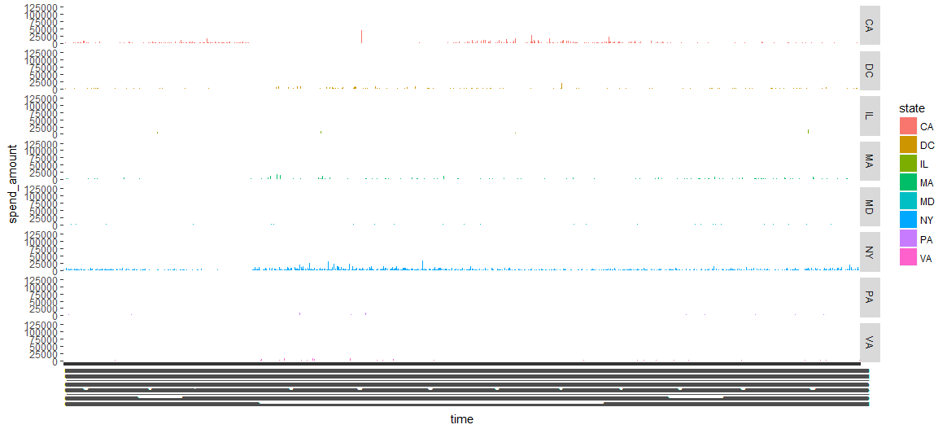
Do NY stores even close?

Slide 23
Users

Slide 24
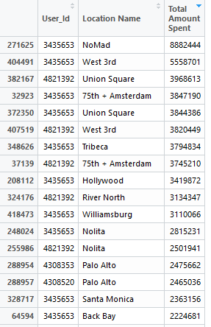
Five User_ids account for the majority of orders overall
The top spending user_ids have orders across states
They’re probably companies getting catered lunches for multiple offices

Slide 25
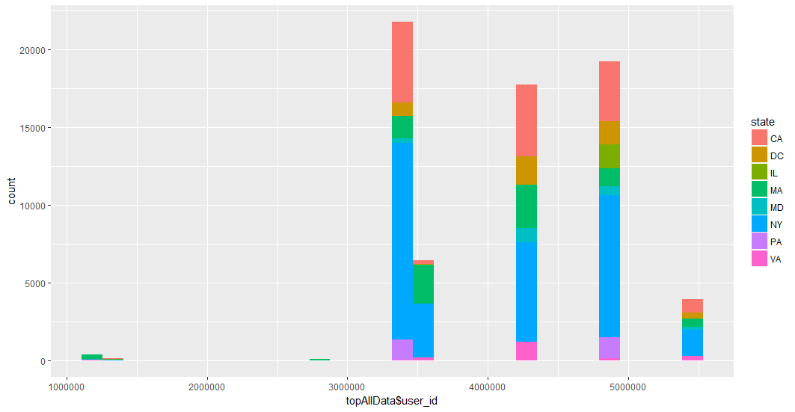
Unless they’re teleporters who love salad

Slide 26
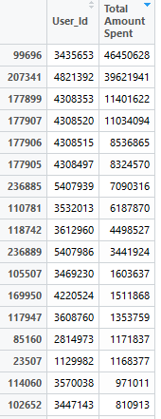
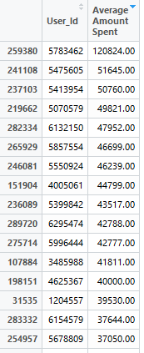
A few people buy a lot of salad
Like, a lot.
Right – users with the highest average order amount
Left – users with the highest cumulative spent amount

Slide 27
Conclusions
They have a high # of orders and/or
They have a high average price per order and/or
They have a high cumulative total spent amount and/or
They spend a lot on guacamole greens and jasmine iced tea
They buy more in the fall
They spend more in CA & NY
NY might dominate because there are more business hours (seems like at least some must be 24 hours)
Tl;dr – Seems like being a multilocation company who orders catering is the ideal customer.

